Slide 1
Hough Line Detection
ENGR 430 Computer Vision
Matthew Stein
Roger Williams University
With material from
Alyssa Quek
https://alyssaq.github.io/2014/understanding-hough-transform/

Slide 2
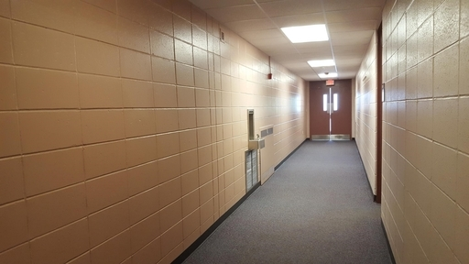
The Hough Transform
The Hough transform (Duda and Hart, 1972), which started out as a technique to detect lines in an image, has been generalized and extended to detect curves in 2D and 3D.
We will use it to detect lines in an image like this

Slide 3

Start with edge-space image
Use OpenCV Canny function
White dots on a black background
Each pixel has a depth of one bit, True/False - it is a white dot or it is not
Endeavor to determine if these dots form a straight line, and if so, what is the equation of that line?

Slide 4
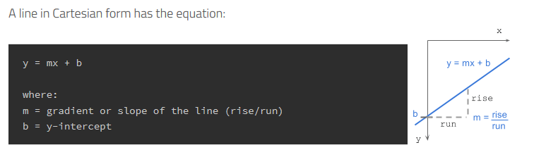

How it works - gradient-intercept parameter space
A single point (x1,y1) in the image can have an infinite combination of slope-intercept pairs representing the infinite possibilities of line that can pass through the point.

Slide 5
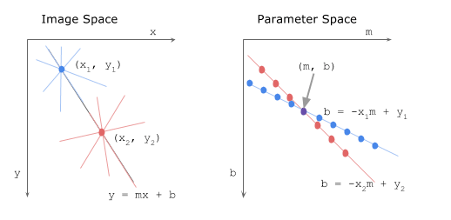
How it works - gradient-intercept parameter space
Say we have 2 edge points (x1,y1) and (x2,y2). For each edge point at various slope values (m=-0.5, 1.0, 1.5, etc), we calculate the corresponding y-intercept b values. The set of blue lines through (x1,x2) in image space are points (dots) in the parameter space. The various red lines through (x2,y2) are red points in parameter space.
Points which are collinear in the Cartesian image space will intersect at a point in m-b parameter space.

Slide 6
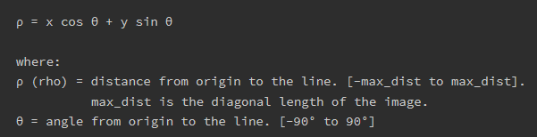
Glitch – vertical lines
Vertical lines have a slope of infinity, mathematically problematic
Same concept but use polar coordinates instead

Slide 7
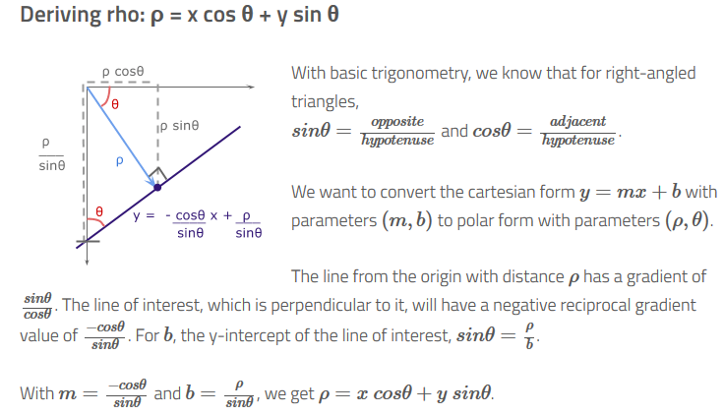
Representing any line
Vertical lines θ=0 Horizontal θ=90°

Slide 8
All lines through a point are a sinusoid in ρ−θ space

Slide 9
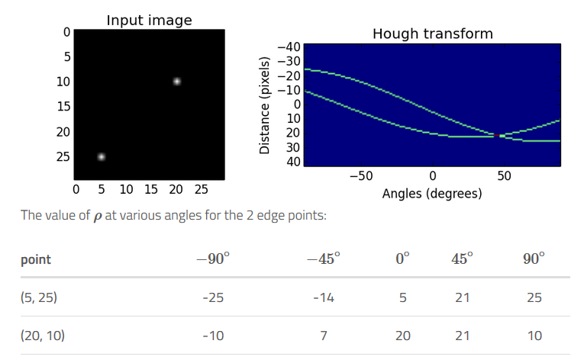
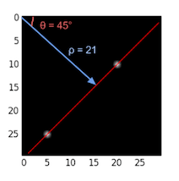
Intersections in Hough space
Line containing both is intersection in Hough space

Slide 10
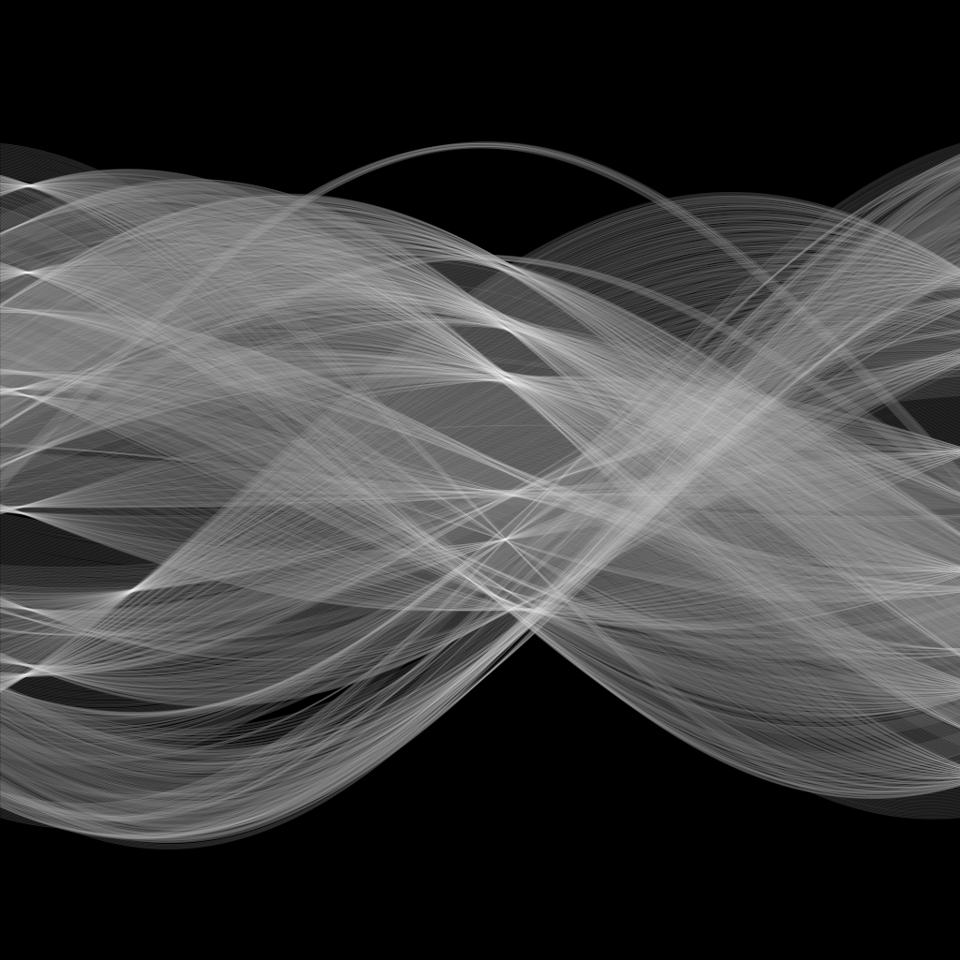
Detecting Lines
Exhaustively check every edge point
O(n²)
Intersections will be the points most visited

Slide 11
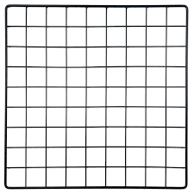
Detecting Lines
Crude 2-D grid of bins in ρ−θ space
Discretize θ from -90° to 90°
Coarse or fine as you choose
For each line increment bin count

Slide 12
Detecting Lines
Choose some number of the most visited bins
Each is a ρ−θ combination representing a line of unspecified length

Slide 13
Hough lines
Each is a ρ−θ combination typically drawn diagonal (max) length
Each line has a “strength” – the number of votes in its bin

Slide 14
Hough lines for navigation
Goal is determining the direction of hallway, lane, road, etc.
Vanishing point of perspective
Ignore vertical and horizontal lines

Slide 15
Hough lines for navigation
Intersection of majority of lines serves as overall direction
Remove vertical and horizontal lines
Find each intersection of every line with all others

Slide 16
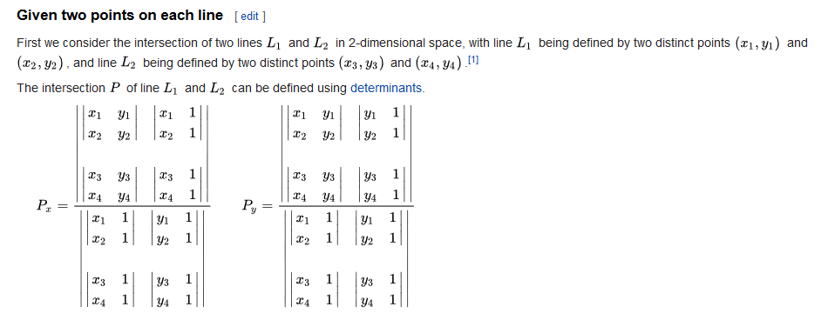
Finding line intersection
* Wikipedia
Lines are not parallel, why?

Slide 17
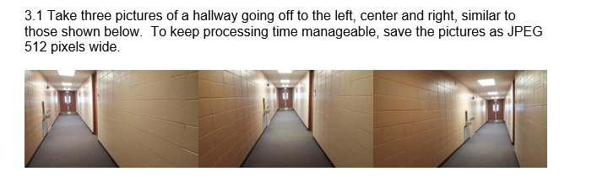
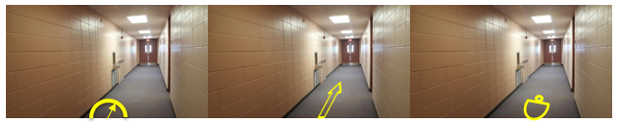
Homework Problem 3.1
Determine dominant hallway directions and place a custom direction indicator at bottom center of image

